Slide 1
Review: Design Eq & Conversion
ν_{j}≡ stoichiometric coefficient; positive for products, negative for reactants
BATCH
SYSTEM:
Ideal Batch Reactor Design Eq with X_{A}:
FLOW
SYSTEM:
Ideal CSTR Design Eq with X_{A}:
Ideal SS PFR Design Eq with X_{A}:
Ideal SS PBR Design Eq with X_{A}:

Slide 2
Review: Sizing CSTRs
We can determine the volume of the CSTR required to achieve a specific conversion if we know how the reaction rate r_{j} depends on the conversion X_{j}
Ideal SS CSTR design eq.
Volume is product of F_{A0}/-r_{A} and X_{A}
Plot F_{A0}/-r_{A} vs X_{A} (Levenspiel plot)
V_{CSTR} is the rectangle with a base of X_{A,exit} and a height of F_{A0}/-r_{A} at X_{A,exit}

Slide 3
Review: Sizing PFRs & PBRs
We can determine the volume (catalyst weight) of a PFR (PBR) required to achieve a specific X_{j} if we know how the reaction rate r_{j} depends on X_{j}
Ideal PFR design eq.
Ideal PBR design eq.
Plot F_{A0}/-r_{A} vs X_{A} (Experimentally determined numerical values)
V_{PFR} (W_{PBR}) is the area under the curve F_{A0}/-r_{A} vs X_{A,exit}
Area = V_{PFR} or W_{catalyst, PBR}

Slide 4
Numerical Evaluation of Integrals (A.4)
Trapezoidal rule (2-point):
Simpson’s one-third rule (3-point):
Simpson’s three-eights rule (4-point):
Simpson’s five-point quadrature :

Slide 5
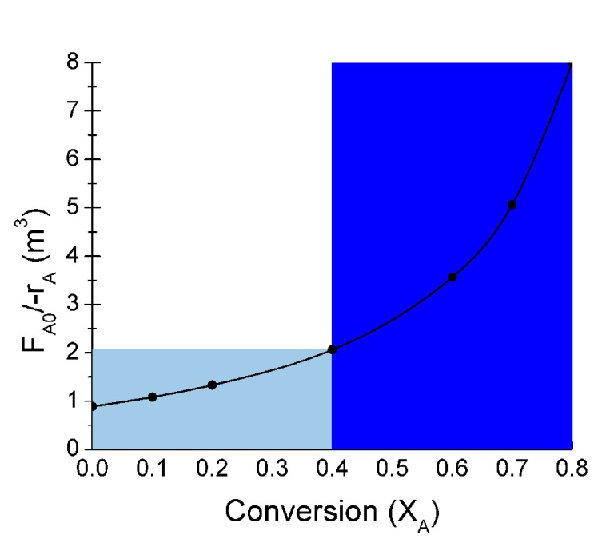
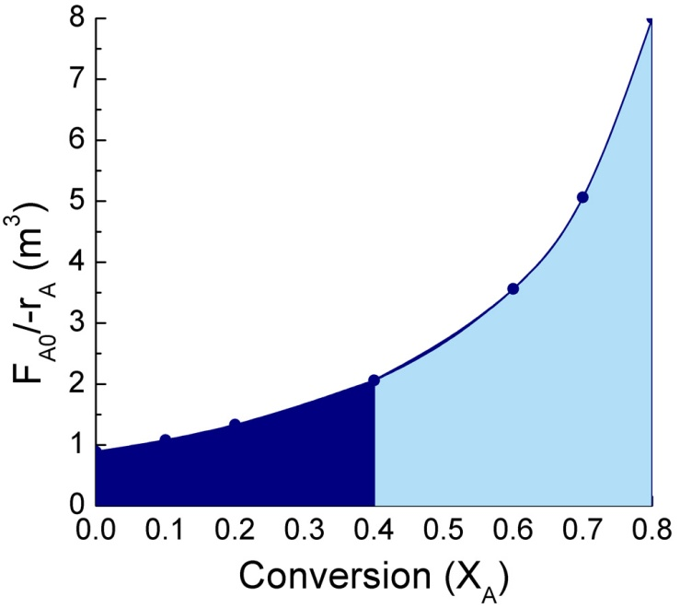
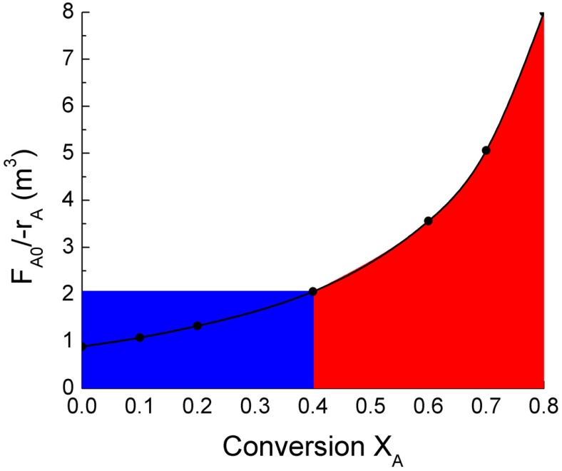
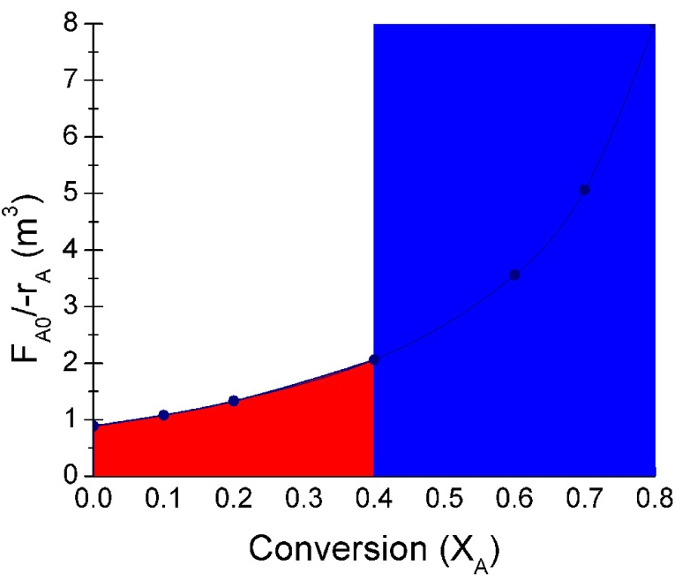
Review: Reactors in Series
If is monotonically
increasing then:
2 CSTRs
2 PFRs
V_{CSTR2}
V_{CSTR1}
V_{PFR1}
V_{PFR2}
CSTR→PFR
PFR→CSTR
V_{CSTR1} + V_{PFR2}
≠
V_{PFR1} + C_{CSTR2}
V_{CSTR2}
V_{CSTR1}
V_{PFR2}
V_{PFR1}

Slide 6
L4: Rate Laws & Stoichiometry
Reaction Rates (–r_{A} )
  Concentration
  Temperature
  Reversible reactions
How to derive an equation for –r_{A} [–r_{A} = f(X_{A})]
Relate all r_{j} to C_{j}
Relate all C_{j} to V or υ
Relate V or υ to X_{A}
Put together

Slide 7
Concentration and Temperature
Molecular collision frequency ∝ concentration
  Rate of reaction ∝ concentration
  At constant temperature : r = f(C_{A}, C_{B}, …….)
C_{A} : Concentration of A
C_{B} : Concentration of B
As temperature increases, collision frequency increases
  Rate of reaction = f [( C_{A}, C_{B}, ……), (T)]
Specific rate of reaction, or rate constant, for species A is a function of temperature
Reaction rate is a function of temperature and concentration

Slide 8
Elementary Reactions & Rate Laws
Dependence of reaction rate –r_{A} on concentration of chemical species in the reaction is experimentally determined
Elementary reaction: involves 1 step (only)
Stoichiometric coefficients in an elementary reaction are identical to the powers in the rate law:
Reaction order:
α order with respect to A
β order with respect to B
Overall reaction order n = α + β
Zero order: -r_{A} = k_{A} k is in units mol/(volume∙time)
1st order: -r_{A} = k_{A}C_{A} k is in units time⁻¹
2nd order: -r_{A} = k_{A}C_{A}² k is in units volume/(mol∙time)
3rd order: -r_{A} = k_{A}C_{A}³ k is in units volume²/(mol²∙time)

Slide 9
Overall Stoichiometric Equations
Overall equations describe the overall reaction stoichiometry
Reaction order cannot be deduced from overall equations
Examples:
This reaction is not elementary, but under some conditions it follows an elementary rate law
Forward reaction is 2nd order with respect to NO and 1st order with respect to O₂ (3nd order overall)
Compare the above reaction with the nonelementary reaction between CO and Cl₂
Forward reaction is 1st order with respect to CO and 3/2 order with respect to Cl₂ (5/2 order overall)

Slide 10
Specific Rate Constant, k_{A}
k_{A} is strongly dependent on temperature
Arrhenius Equation
Where :
A = Pre-exponential factor or frequency factor (1/time)
E = Activation energy, J/mol or cal/mol
R = Gas constant, 8.314 J/mol K (or 1.987 cal/mol K)
T = Absolute temperature, K
Taking ln of both sides:
ln k
-E/R
To determine activation energy E, run the reaction at several temperatures, and plot ln k vs 1/T. Slope is –E/R
1/T

Slide 11
Reversible Reactions
Rate of disappearance of A (forward rxn):
Rate of generation of A (reverse reaction):
At equilibrium, the reaction rate is zero, r_{A}=0
Thermodynamic equilibrium relationship
K_{C}: concentration equilibrium constant (capital K)
K_{C} is temperature dependent (no change in moles or ΔC_{P}):
ΔH_{RX}: heat of reaction
If K_{C} is known for temperature T₁, K_{C} for temperature T can be calculated

Slide 12
L4: Rate Laws & Stoichiometry
Reaction Rates (–r_{A} ) ☑
  Concentration ☑
  Temperature ☑
  Reversible reactions ☑
How to derive an equation for –r_{A} [–r_{A} = f(X_{A})]
Relate all r_{j} to C_{j}
Relate all C_{j} to V or υ
Relate V or υ to X_{A} (Wednesday)
Put together (Wednesday)

Slide 13
1. Relate all r_{j} to C_{j}
r_{A} as a function of C_{j} is given by the rate law
The rate relative to other species (r_{j}) is determined by stoichiometry
“A” is the limiting reagent
r_{j} is negative for reactants, positive for products
ν_{j}≡ stoichiometric coefficient
positive for products, negative for reactants
In general:

Slide 14
For the reaction the rate of O₂ disappearance is 2 mol/dm³•s (-r_{O2}= 2 mol/dm³•s).
What is the rate of formation of NO₂?
  r_{NO2} = 4 mol/dm³•s

Slide 15
2a. Relate all C_{j} to V (Batch System)
Reaction rate is a function of C_{j}:
How is C_{j} related to V and X_{A}?
Batch:
Put N_{A} in terms of X_{A}:
Do the same for species B, C, and D:
C_{j} is in terms of X_{A} and V. But what if V varies with X_{A}? That’s step 3a!

Slide 16
2a. Additional Variables Used in Textbook
Book uses term Θ_{i}:
So species N_{i0} can be removed from the equation for C_{i}
Multiply numerator by N_{A0}/N_{A0}:

Slide 17
3a. Relate V to X_{A} (Batch System)
Volume is constant (V = V₀) for:
  Most liquid phase reactions
  Gas phase reactions if moles reactants = moles products
If the volume varies with time, assume the equation of state for the gas phase:
At time t: PV = ZN_{T}RT and at t=0: P₀V₀ = Z₀N_{T0}RT₀
P: total pressure, atm Z: compressibility factor
N_{T}: total moles T: temperature, K
R: ideal gas constant, 0.08206 dm³∙atm/mol∙K
Want V in terms of X_{A}. First find and expression for V at time t:
What is N_{T} at t?
N_{T} at time t is:

Slide 18
3a. Relate V to X_{A} (continued)
Can we use the eq. for N_{T} above to find an expression for N_{T}/N_{T0}?

Slide 19
What is the meaning of ε?
where
If we put the following equation in terms of ε:
When conversion is complete (X_{A}=1):
The expansion factor, ε, is the fraction of change in V per mol A reacted that is caused by a change in the total number of moles in the system

Slide 20
4a. Put it all together (batch reactor)
Batch:
For a given X_{A}, we can calculate C_{j} and plug the C_{j} into –r_{A}=kC_{j}^{n}
What about flow systems?

Slide 21
2b. Relate all C_{j} to υ (Flow System)
Reaction rate is a function of C_{j}:
How is C_{j} related to υ and X_{j}?
Flow:
Put F_{A} in terms of X_{A}:
Do the same for species B, C, and D:
We have C_{j} in terms of X_{A} and υ, but what if υ varies with X_{A}? That’s step 3b!

Slide 22
3b. Relate υ to X_{A} (Flow System)
Start with the equation of state for the gas phase:
Rearrange to put in terms of C_{T}, where C_{T} = N_{T}/V:
Can we relate C_{T} to υ?
Rearrange to put in terms of υ:
What is C_{T0} at the entrance of the reactor?
Use these 2 equations to put υ in terms of known or measurable quantities
Put in terms of υ₀:

Slide 23
3b. Relate υ to X_{A} (continued)
When conversion is complete (X_{A}=1):

Slide 24
4b. Put it all together (flow reactor)
Flow:
This is the same equation as that for the batch reactor!
For a given X_{A}, we can calculate C_{j} and plug the C_{j} into –r_{A}=kC_{j}^{n}

Slide 25
4. Summary: C_{j} in terms of X_{j}
Batch:
Flow:
This is the same equation as that for the batch reactor!
For a given X_{A}, we can calculate C_{j} and plug the C_{j} into –r_{A}=kC_{j}^{n}

